Slide 1
Immigration Law Update and How to Work with Interpreters
Kathleen McDonald, Partner
Beacon Legal Group, PLLC
Arkansas Bar Association
Annual Meeting
June 13-15, 2018
Mara Simmons, Administrative Office of the Courts
Gerry Schulze, Attorney at Law

Slide 2
Developments in Immigration

Slide 3
To ensure due process, Arkansas courts have the obligation to provide language access so that every individual who appears in court can understand and effectively participate in the proceedings.

Slide 4
Supreme Court Delivers Per Curiam
Supreme Court of Arkansas delivers Per Curiam on
September 30, 1999.
“All persons, whether or not able to understand or communicate adequately in the English language, must be afforded rights when they appear in court. It is the intent of this Per Curiam Order to provide for the certification, appointment and use of interpreters for non-English speaking parties or witnesses in all state and local court proceedings.

Slide 5
It’s The Law
Arkansas Code Ann. § 16-10-1101 to § 16-10-1108
Court Interpreters
§ 16-10-1104. Appointment of interpreters
§ 16-10-1108. Compensation of interpreter
Arkansas Rules of Evidence. Rule 1009
Translation of Foreign Language Documents and Recordings

Slide 6
Role of the Interpreter
To place the Limited English Proficiency (LEP) individual, as closely as is linguistically possible, in the same situation as an English hearing person of the same level of intelligence and education without giving an advantage or disadvantage.

Slide 7
How Do They Do It?
SERVE AS A CONDUIT
MAINTAIN TRUE MEANING
CONSERVE LANGUAGE LEVEL
WITHOUT CHANGING, ADDING, DELETING, OMITTING
CODE OF ETHICS
1 of 3
Notes:
GLASS CONDUIT, CRYSTAL CLEAR. CONFIDENTIALITY, Linguist who specializes in the transfer of messages from the source language to the target language.
COURT INTERPRETING IS A HIGHLY SPECIALIZED FORM OF INTERPRETING

Slide 8
What’s wrong with this?
Colorless green ideas sleep furiously.
What did you bring that book that I did not want to be read to out of up for?

Slide 9
How about this?
Heu, modo itera omnia quae mihi nunc nuper narravisti, sed nunc Anglice.
--Henry Beard, Latin for All Occasions, p. 35.

Slide 10
How languages work
Let’s take a language we’re all familiar with from our work in the legal profession: Latin.
What is the Latin word for “thing” or “matter”? As in
In the matter of
The thing speaks for itself. Or “the thing is adjudicated”
Against the thing (as opposed to Against the person)

Slide 11
Res
Res ipsa loquitur. The thing speaks for itself.
Res judicata. The matter is decided.
In rem. Against the thing
In re. In the matter of
Rebus sic stantibus. In these circumstances.

Slide 12
What about “day”?
The legislature adjourns “sine die.”
The legislators receive a “per diem.”

Slide 13
Forms of “res” in Latin
Case | Singular | Plural | Singular | Plural
Nominative | res | res | dies | dies
Genitive | rei | rerum | diei/die | dierum
Dative | rei | rebus | diei/die | diebus
Accusative | rem | res | diem | dies
Ablative | re | rebus | die | diebus
Locative |  | rebus |  | diebus
Vocative | res | res | dies | dies

Slide 14
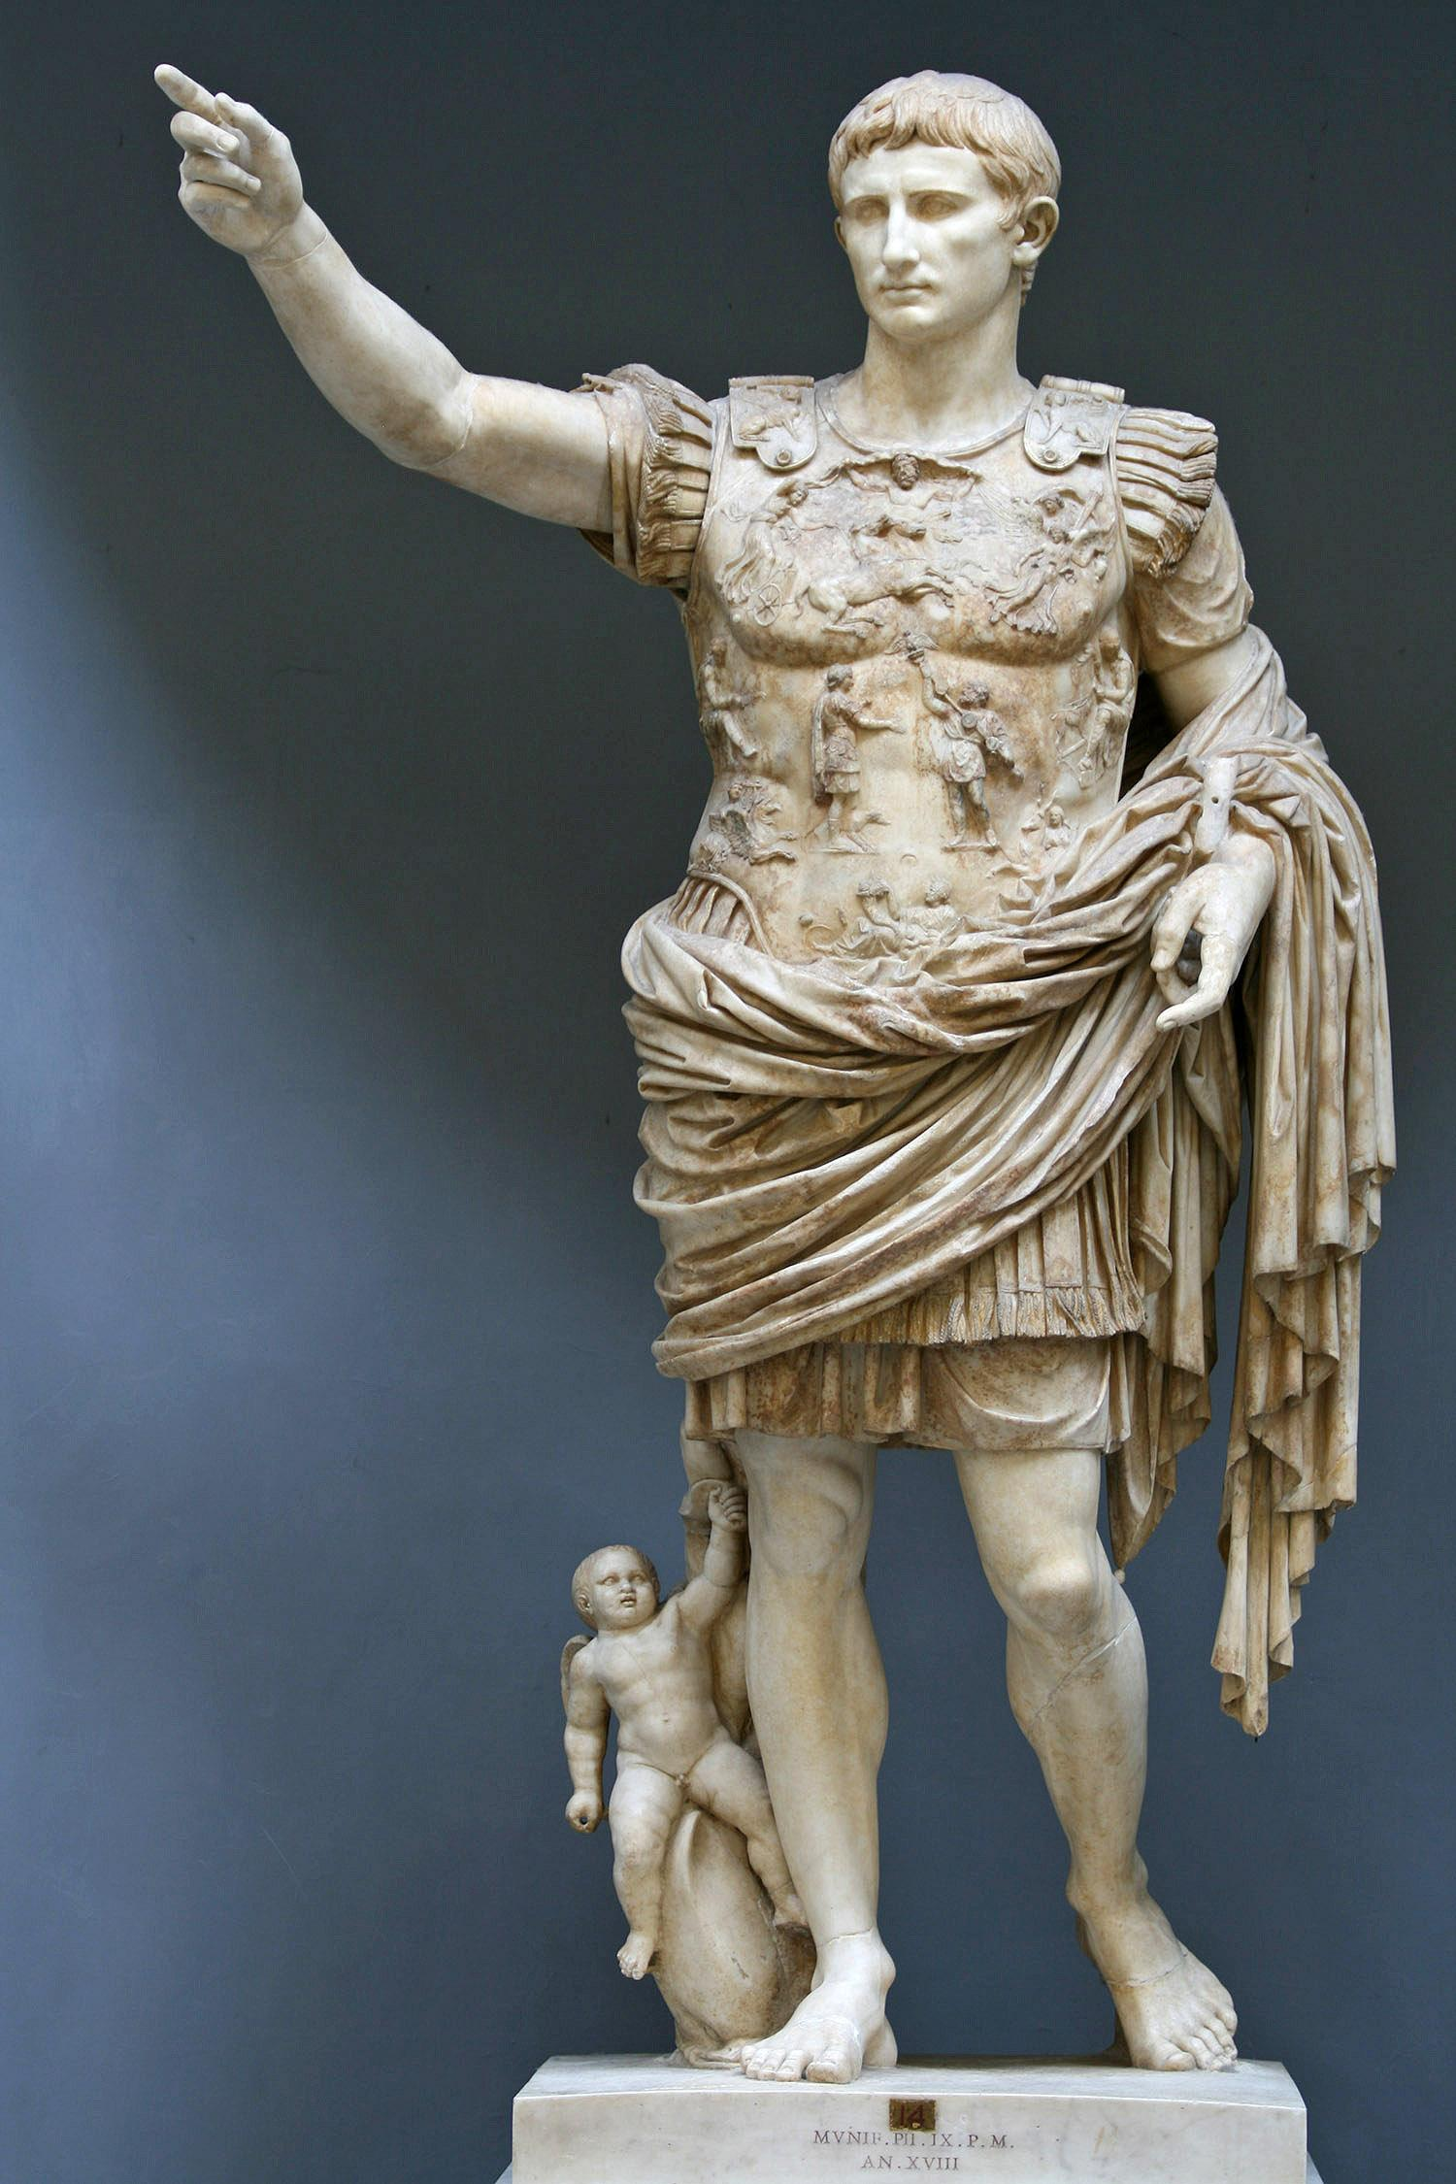
Fortunately
We seldom have to deal with ancient Romans in court.
But we do deal with speakers of the daughter of the Latin language.

Slide 15
Understanding the problem
Monolingual
Bilingual
Interpreter
Most of us are effectively monolingual. Some of us speak a second language as we learned it in school.
It is difficult to even know what kinds of problems speakers of other languages have
Some of us are bilingual. Often that is because of situations of our birth or growing up.
We may speak languages with varying degrees of fluency or in varying circumstances.
An interpreter is not only bilingual, but is also trained in dealing with the problems that can arise in translation.

Slide 16
Bilingualism
“Bilingualism on its own is not a guarantee of written fluency or skill in translation. Professional translators are first and foremost writers, capable of producing texts that read well in the target language. Bilingualism is something else. Bilinguals speak two languages fluently, but are not necessarily good at moving information between the two, especially in writing. Experience shows that many people who describe themselves as bilingual over-estimate their communications skills altogether.”
American Translators Association (ATA)- “Translation – Getting it Right; A Guide to Buying Translations” A. Aparicio & C. Durban 2003.

Slide 17
Names
In Spanish-speaking countries, most people go by an apellido paterno and and apellido materno. That is a combination of a father’s first last name and a mother’s first last name.

Slide 18
When you need an interpreter
Does the individual understand what is going on without an interpreter?
Don’t depend on a good accent. Some people have a good ear, but may still need an interpreter for something as important as court.

Slide 19
“Word-for-Word” translation
Spanish | Literal Translation | Correct Translation
Andaba bien pedo. | He walked real fart | He was smashed
Las utilidades se dispararon cuando la oferta aumentó. | The utilities shot themselves when the offer increased. | The profits sky-rocketed when the supply increased.
Es que yo a ella no la conozco. | Is that I to her don’t know her | The thing is, I don’t know her.
El hombre del pelo chino dijo que lo había hecho para pagar una droga. | The man with the Chinese hair said he had done it to pay off a drug. | The curly-haired man said he had done it to pay off a debt.
Haydee Claus, Court Interpreting: Complexities and Misunderstandings, Alaska Justice Forum, (1997)

Slide 20
Assess the need for an interpreter as soon as possible.
If you suspect limited English proficiency, make sure that your client or witness is understanding you. Ask questions. Listen to the answers. Are they responsive? Are they appropriate to the question?
If the answers don’t indicate that you are communicating, consider the need for an interpreter. This can be a challenge. Sometimes people just don’t listen. You have this problem in single-language communications with some people.

Slide 21
Give the interpreter time and information to prepare.
It is good for the interpreter to talk to the witness to assess language skills and any possible problems with dialect.
If the subject matter of the discussion is unusual in any way, let the interpreter know so that he or she can prepare with specialized vocabulary that might be necessary.
Word-for-word correspondence is not always available. Some words in English may have multiple translations in the target language, and vice-versa. If the interpreter knows the general fact situation involved, it is easier to avoid confusion.

Slide 22
Role of Interpreter
Remember the role of the interpreter. The interpreter is there to translate from one language to another. The interpreter is not allowed to add any content to the conversation. Don’t ask the interpreter to “explain” the court system to the witness. The lawyer must give the explanation. The interpreter will translate what is said.

Slide 23
Computer Assisted Translation
Even the best computer-based translation is not ready for prime time. Don’t depend on computerized translation for anything important.
Don’t be surprised, however, to learn that some translators use software to assist in translation. Remember, however, that is only good for production of a rough draft.

Slide 24
What the Interpreter is not supposed to do.
Don’t ask the Interpreter to “explain” something to the witness/client. You do the explaining, and the interpreter will interpret what you say.
An interpreter is not a “lie detector.” Don’t take the interpreter aside and ask if the witness is telling the truth.

Slide 25
Fail Safe (1964)
This was a movie about a computer error creating the possibility of a nuclear conflict between the United States and the Soviet Union.
In a dramatic scene, the president prepares to talk to the Soviet leader.

Slide 26
The President: Buck, I'll talk to the Soviet premier now. You'll translate what he says to me. He'll have his own translator telling him what I say...but I want something more from you. The premier says what he means.but sometimes there's more in a man's voice than in his words. There are words in one language that don't mean the same in another. You follow me? Buck: I think so, sir.
The President: It's very important the premier and I understand each other. I don't have to tell you that. So I want to know what he's saying and what you think he's feeling. Any inflection of his voice, any tone..any emotion that adds to his words...I want you to let me know. Buck: Yes, sir. I'll do my best. The President: I know you will. It's all any of us can do.

Slide 27
Unless you’re the President, and nuclear armageddon is imminent: Don’t ask an interpreter to do this.

